Slide 1
Chapter 23: Operational Amplifiers (Part 4)
Comparators
Coverage :
Section 23-7 (Pg 468 – 474) of textbook

Slide 2
Objectives
After completing Part 4 of this chapter, you will be able to:
Understand the operation of basic comparator circuits.
Understand the use of hysteresis to reduce the effect of noise.

Slide 3
COMPARATORS
Op-amps used as comparators:
compare amplitudes of one voltage with another
determines when an input voltage exceeds a certain level
Achieved by operating in open-loop configuration - input voltage on one input and a reference on the other
Can you recall the implications of operating op-amps in the open-loop configuration? (hint: it has to do with the voltage gain)

Slide 4
Op Amp in the Open-loop Configuration
V_
+15V
V_{out}
+
V₊
-15V
V_{out} = A_{ol} V_{in}
= A_{ol} ( V₊ - V₋ )

Slide 5
23-7 Op Amp Comparators
3 major types of Op-Amp Comparators:
Zero level comparator (or detector)
Non-zero level comparator
Comparator with hysteresis

Slide 6
Zero Level Comparator
+15V
Very small difference in voltage between the two inputs drives the amplifier into saturation
+
V_{out}
-15V
V_{in}
E.g. If A_{ol} = 100,000 & voltage difference between the inputs = 0.25mV
Output voltage = (0.25mV)(100,000) = 25V
The op-amp will be driven into saturation.

Slide 7
V_{in} = V₊
+15V
V_
V_ = 0V
t
V₊
V_{out}
+
V₊> V_
V_> V₊
-15V
+V_{o(sat)}
V_{in}
V_{out}
t
-V_{o(sat)}
To predict the output voltage of a comparator is to compare the voltages at V₊ and V_
V₊ > V_ causes V_{out} = +Vsat
V_> V₊ causes V_{out} = -Vsat

Slide 8
Non-zero Level Comparator
V₊ > V_ V_{out} = +V_{o(sat)}
V_
+15V
V_ > V₊ V_{out} = -V_{o(sat)}
V₊
V_{out}
+
Vref
-15V
+15V
V_{in}
R₁
V_
Vref
V₊
+
V_{out}
R₂
-15V
V_{in}

Slide 9
Non-zero Level Comparator
V_{out}
V_{in} = V₊
V_ = V_{ref}
V_
+15V
t
V₊
+
+V_{o(sat)}
Vref
-15V
V_{out}
V_{in}
t
V₊ > V_ V_{out} = +V_{o(sat)}
-V_{o (sat)}
V_ > V₊ V_{out} = -V_{o(sat)}
V_> V₊
V₊> V_
V₊> V_

Slide 10

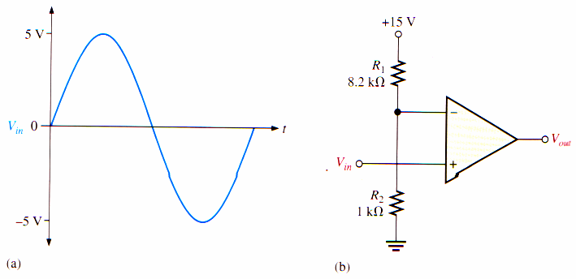

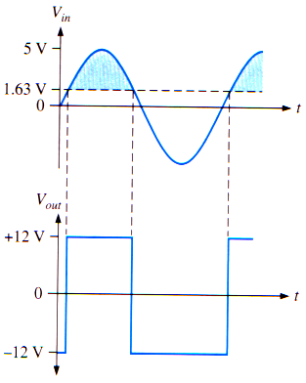

EXAMPLE 23.6
23-32
23-32
23-33
10
Copyright © 2005 Tan Hua Joo, Singapore Polytechnic

Slide 11
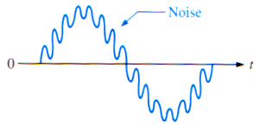
Effects of Input Noise on Comparator Operation
In many practical situations, unwanted voltage fluctuation (noise) appear on the input line
This noise voltage becomes superimposed on the input voltage and can cause a comparator to erratically switch output states
Sine wave with
superimposed noise

Slide 12
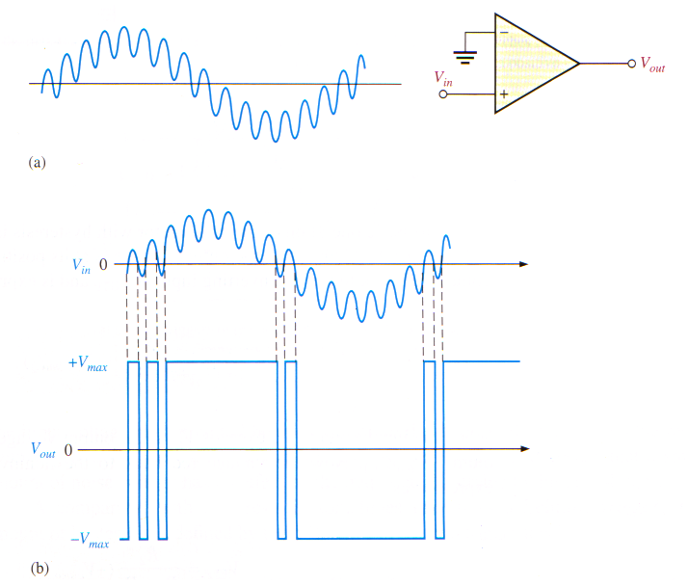
Effects of noise on comparator circuit

Slide 13
Reducing Noise Effect with Hysteresis
To make the comparator less sensitive to noise, applying positive feedback in an op-amp circuit - hysteresis
+V_{S}
V_{out}
V_{in}
+
R₁
-V_{S}
Hysteresis → higher reference level when the input voltage goes from a lower to a higher value than when it goes from a higher to a lower value
R₂
The two reference voltages are referred to as the upper trigger point (UTP) and the lower trigger point (LTP)

Slide 14
Assuming that the output voltage is at its positive maximum, +V_{o(sat)}
The voltage fed back to the non-inverting input is V_{UTP} expressed as:
V_{in}<V_{UTP}
V_{in}
+V_{S}
+V_{o(sat)}
+V_{S}
V_{UTP}
+V_{o(sat)}
+
+
R₁
R₁
-V_{S}
-V_{S}
-V_{o(sat)}
R₂
R₂
V_{UTP}
V_{UTP}
Input exceeds V_{UTP} , output switches from the maximum positive voltage to the maximum negative voltage
Output at the maximum positive voltage

Slide 15
When the input voltage exceeds V_{UTP}, the output voltage drops to its negative maximum, -V_{o(sat)}
Now the voltage fed back to the non-inverting input is V_{LTP} expressed as:
V_{in}>V_{LTP}
V_{in}
+V_{o(sat)}
+V_{S}
+V_{S}
-V_{o(sat)}
V_{LTP}
+
+
R₁
-V_{S}
R₁
-V_{o(sat)}
-V_{S}
R₂
R₂
V_{LTP}
V_{LTP}
Input goes below LTP, output switches from the maximum negative voltage to maximum positive voltage
Output at the maximum negative voltage

Slide 16
V₋ = V_{in}
V₊ = V_{UTP}
0
V₊ = V_{LTP}
+Vout(max)
-Vout(max)

Slide 17
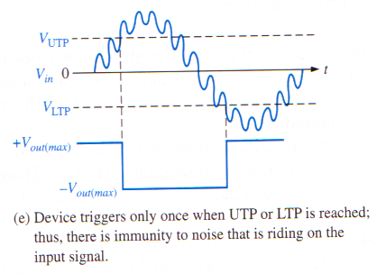
To switch from the maximum negative voltage back to the maximum positive voltage, input voltage must now fall below V_{LTP}
Small amount of noise voltage therefore has no effect on the output
A comparator with hysteresis is also called a Schmitt trigger
The amount of hysteresis is defined by the difference of the two trigger levels
V_{HYS} = V_{UTP} - V_{LTP}

Slide 18
EXAMPLE 23-7
Calculate the upper and lower trigger points for the comparator circuit shown below. Assume +Vsat = 8V and –Vsat = -8V
+V_{S}
V_{out}
V_{in}
+
R₁ = 120KΩ
-V_{S}
R₂ = 120KΩ
Solution

Slide 19
Summary
Comparators consist of op-amps that operate in the open-loop mode.
The zero-level comparator (or detector) compares the input signal with zero voltage level.
With the hysteresis feature, a comparator switches output states only when the input signal exceeds either the preset upper trigger point (UTP) or lower trigger point (LTP).

Slide 20
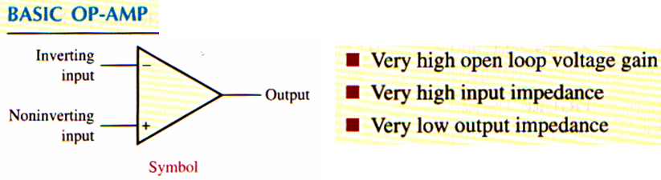
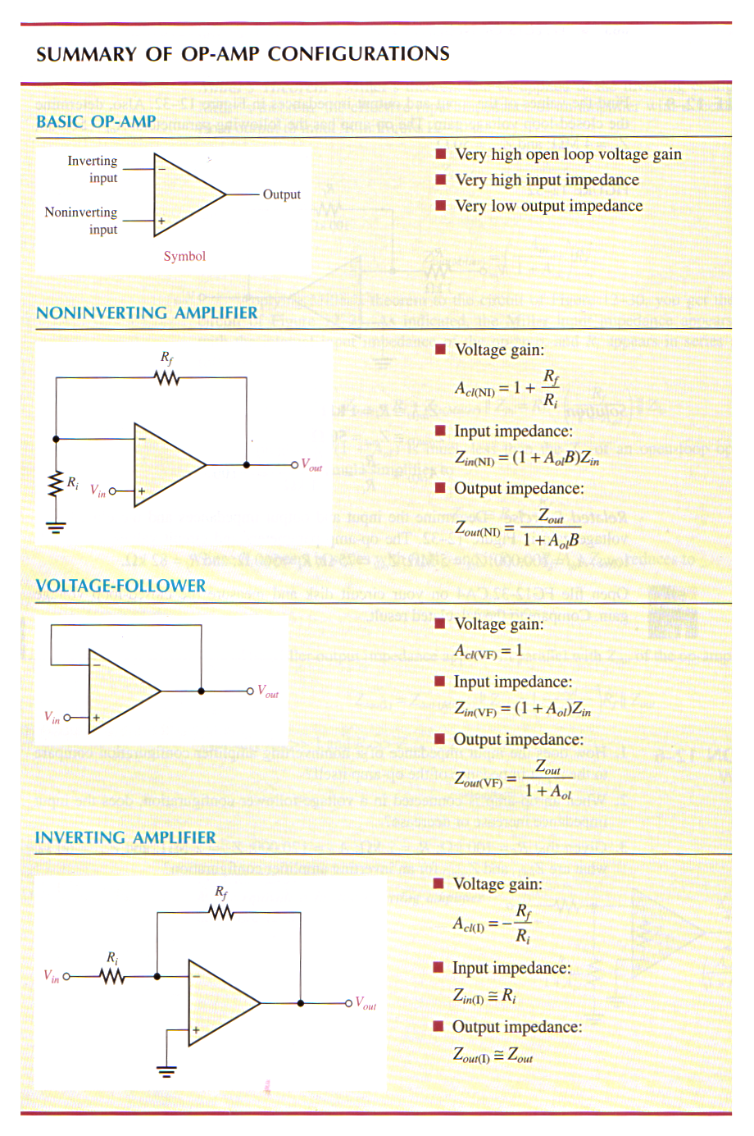
Summary

Slide 21

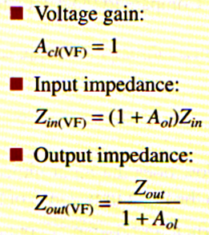
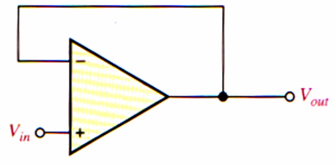

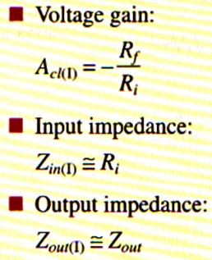
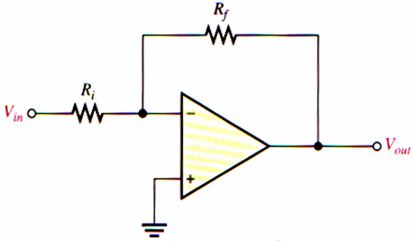

Slide 22

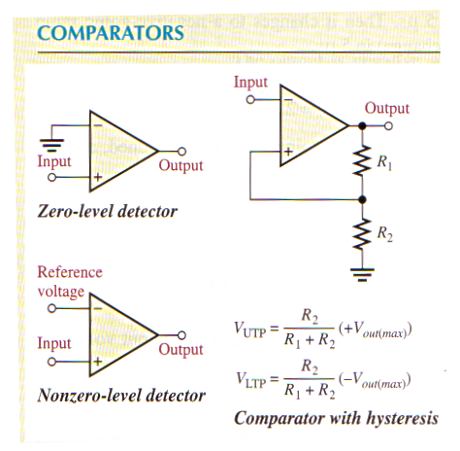

Slide 23
End of Chapter 23

